Slide 1

AutoIntel AI
Intelligent Vehicle Diagnosis and Maintenance Assistant
Summer Internship Project — Tata Motors, Technologies Department, Jamshedpur
Presented by:
Aadya Mishra
Sukhmeet Kaur
Ankita Manna
Shivantika Singh
Guide: Tata Motors, Technologies Department

Slide 2
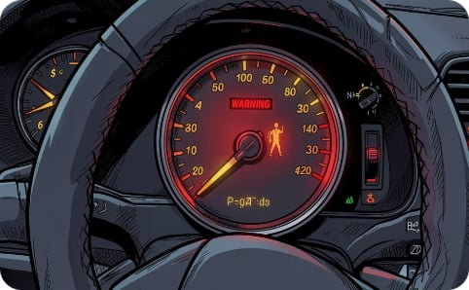
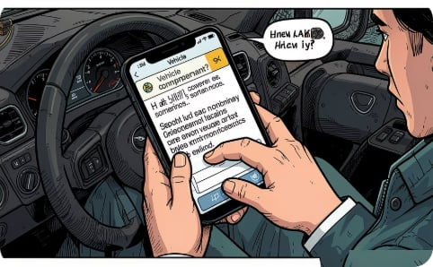
Problem Statement
Why AutoIntel AI?
Existing challenges
Our solution
Modern vehicles emit complex OBD-II codes that most owners cannot interpret. Diagnosis typically needs specialised scanners and professional mechanics, increasing time, cost and service dependency.
AutoIntel AI lets users describe problems in plain language and returns probable faults, OBD-II codes, repair steps, estimated cost & time, plus preventive maintenance advice.

Slide 3
Project Objectives
Deliver an AI-powered diagnostic assistant that converts user complaints into actionable vehicle diagnoses. Key goals:
NLP Complaint Analysis
Fault Identification
Repair Guidance
Parse natural-language complaints to extract symptoms and context.
Predict most probable faults and map to OBD-II codes.
Provide repair procedures, estimated cost and repair time.
Preventive Maintenance
User Experience
Offer recommendations to reduce future failures and improve vehicle health.
Intuitive web UI for fast, explainable diagnostics and downloadable reports.

Slide 4
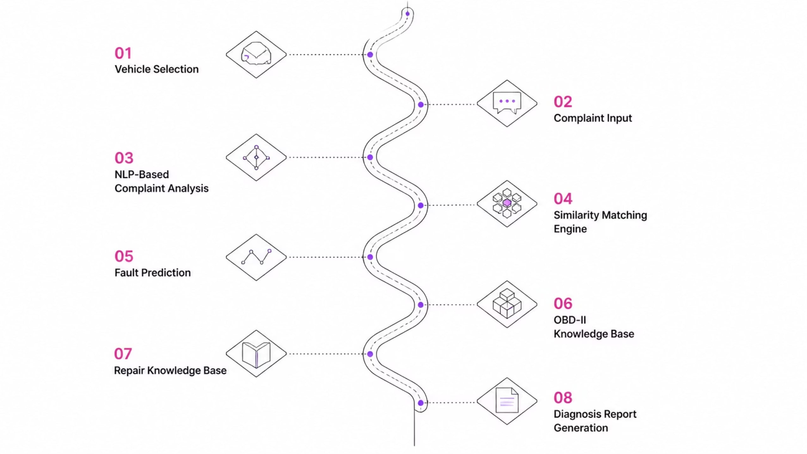
Project Workflow
This comprehensive workflow outlines the journey of a user query, from initial complaint to a detailed diagnostic report, leveraging advanced AI and knowledge bases at each stage.

Slide 5
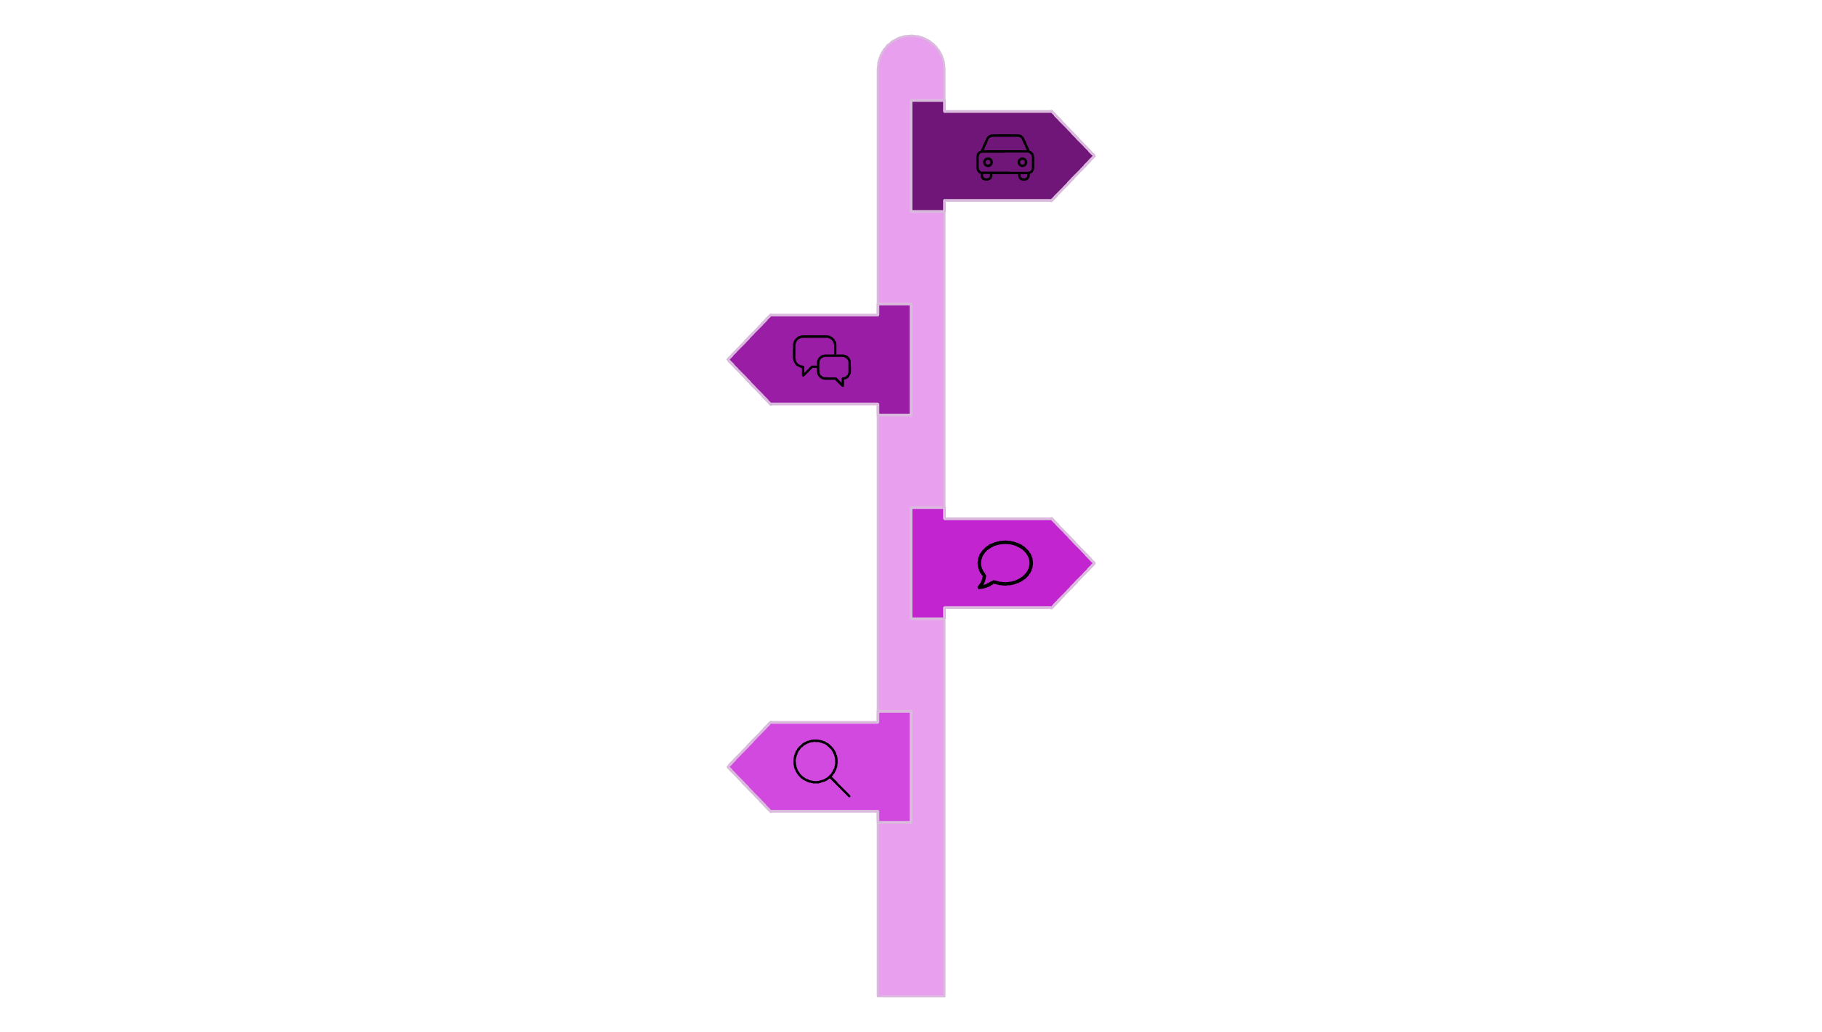
System Architecture — Overview
Vehicle Selection
Choose vehicle make, model, and year.
Complaint Input
Enter plain-language symptom description.
NLP Analysis
Extract entities and intents from text.
Similarity Matching
Find similar cases and historical patterns.

Slide 6
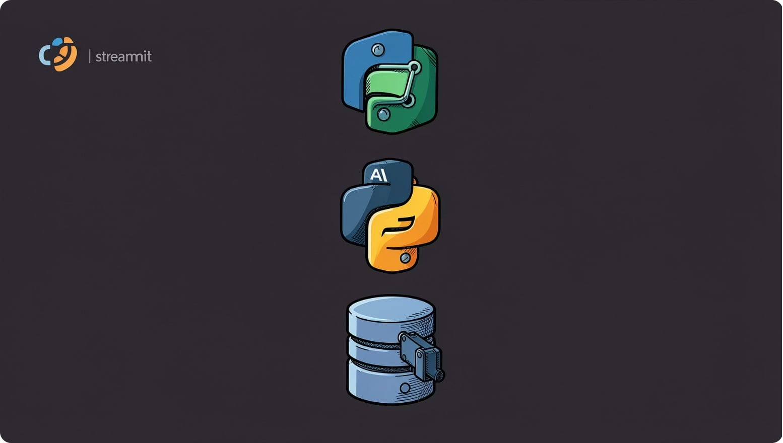
System Architecture — Core Modules
Core modules
Streamlit user interface — guided complaint input & results view
NLP engine — sentence transformers for semantic embedding
Similarity matching engine — nearest-neighbour retrieval
SQLite knowledge stores — vehicle master, OBD-II, repairs
Report generator — PDF export with explanations and scores
Each module is designed for modular testing and future scaling to cloud databases and real-time OBD-II connections.

Slide 7
Technology Stack
Frontend
Database
Data
AI
Streamlit — rapid prototyping, interactive widgets
SQLite — compact, easy to integrate during prototyping
Pandas — ETL for vehicle & repair datasets
Sentence Transformers + similarity matching — explainable retrieval-based predictions
Stack Rationale
Lightweight deployment, explainability, and easy migration to cloud services when scaling

Slide 8
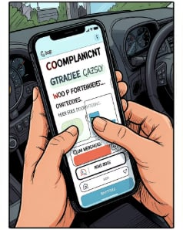
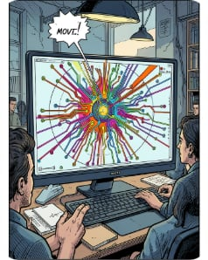
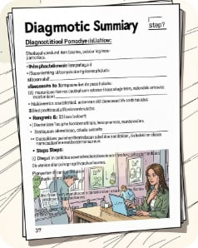
Implementation & Key Features
User-friendly input
Explainable AI
Deliverables
Natural-language complaint capture with optional structured fields (vehicle model, mileage, recent events).
Similarity scores and example complaints shown to justify predictions.
PDF diagnosis reports with fault ranking, OBD-II codes, repair steps, cost & time estimates, and preventive actions.
Supports multiple faults diagnoses, alternative recommendations, and a vehicle health score to prioritise interventions.

Slide 9

Results & Achievements
What we validated
Accurate mapping from complaints to probable faults and OBD-II codes
Generation of actionable repair procedures with time & cost estimates
Explanation via similarity scores and example matches
Downloadable diagnostic reports for users and service centres
Impact
Speeds preliminary diagnosis, lowers unnecessary service visits, improves owner understanding, and helps service centres prioritise repairs.
Comparison
Aspect
Traditional Diagnosis
AutoIntel AI
Input
Manual inspection / scanner
Natural language complaint
Speed
Time-consuming
Near-instant preliminary diagnosis
Guidance
Requires technical expertise
Repair steps, cost & time estimate

Slide 10

Future Scope
Enhanced analysis
Real-time data
Scale & platform
Integrate LLMs to improve contextual understanding and multi-complaint reasoning.
Connect to OBD-II scanners for live telemetry, error streaming and sensor-level diagnostics.
Migrate to cloud databases (PostgreSQL/MongoDB) and microservices for fleet-scale deployments.
Mobile & accessibility
Predictive maintenance
Native Android/iOS apps, voice input and multilingual support for wider adoption.
Use time-series and ML models to predict failures and schedule proactive service.
Long-term vision: a real-time intelligent automotive assistant for drivers, service centres and fleet managers.

Slide 11

Conclusion
AutoIntel AI demonstrates a practical, explainable application of AI and NLP to simplify vehicle diagnostics. It bridges user language and technical OBD-II knowledge to deliver actionable, cost-aware repair guidance and preventive recommendations.

Slide 12
Thank You

